Slide 1
Low Power Digital Circuit Design
S. Qureshi
Department of Electrical Engineering
Indian Institute of Technology Kanpur
Kanpur-208016
India
11/28/19
S Qureshi

Slide 2
Low Power Circuit Design
Motivation
Historical perspective
Sources of power dissipation
Low power design methodology
11/28/19
S Qureshi

Slide 3
Motivation - Why Low Power Design?
    Need for low power chips in industry
    - Low power Consumer electronics is powered by batteries
    - Craving for smaller, lighter and durable electronic products which translates into low power chip design
    - Battery life is a differentiator in many electronic products
    - Growth experienced by portable systems not been matched by growth in battery technology, therefore need to reduce energy consumption in chips
11/28/19
S Qureshi

Slide 4
Motivation- Why Low Power Design?
    Need low power chips for high performance computing
    - High performance computing systems characterized by large power dissipation also drives low power needs
    - A typical computing server can consume as high as 20 KW in server farm
    - Power dissipation having direct impact on packaging cost of chip and cooling cost of system
    - Low power methodologies needed to reduce packaging and cooling cost
11/28/19
S Qureshi

Slide 5
Why Low Power Design?
10000
Rocket
Nozzle
1000
Nuclear
Power Density (W/cm2)
Reactor
100
8086
10
4004
Hot Plate
P6
8008
8085
386
Pentium® proc
8080
286
486
1
1970
1980
1990
2000
2010
Year
Power density too high to keep junctions at low temp
11/28/19
S Qureshi
Courtesy, Intel

Slide 6
Motivation- Why Low Power Design?
    Reliability of a Silicon chip
    - Reliability of chip closely related to power dissipation
    - Every 10 degree Centigrade rise in temperature doubles failure rate
    Need low power chips to address environmental concern
    - Large office equipment consumes huge power
    - Computers are fast growing electricity loads
    - 7% of energy is consumed in office equipment in the US
    - Electricity generation is major source of air pollution
    - Efficient energy usage in computers is highly desirable
11/28/19
S Qureshi

Slide 7
Historical Perspective
    Pocket calculators
    Hearing aids
    Implantable pace makers
    Portable military equipment
    Wristwatches
    Portable computing
11/28/19
S Qureshi

Slide 8
Recent Advances in Low Power Applications
    Multi-media
    Video display and capture
    Audio reproduction
    Notebook computing
    Cell phones
11/28/19
S Qureshi

Slide 9
Sources of Power Dissipation
Sources of Power dissipation
    Dynamic Power
    Switching power
    Short circuit power
    Glitching power
    Static power
    Reverse biased PN junction diode leakage
    Subthrehold leakage current
    Gate leakage current
    Other effects !
11/28/19
S Qureshi

Slide 10
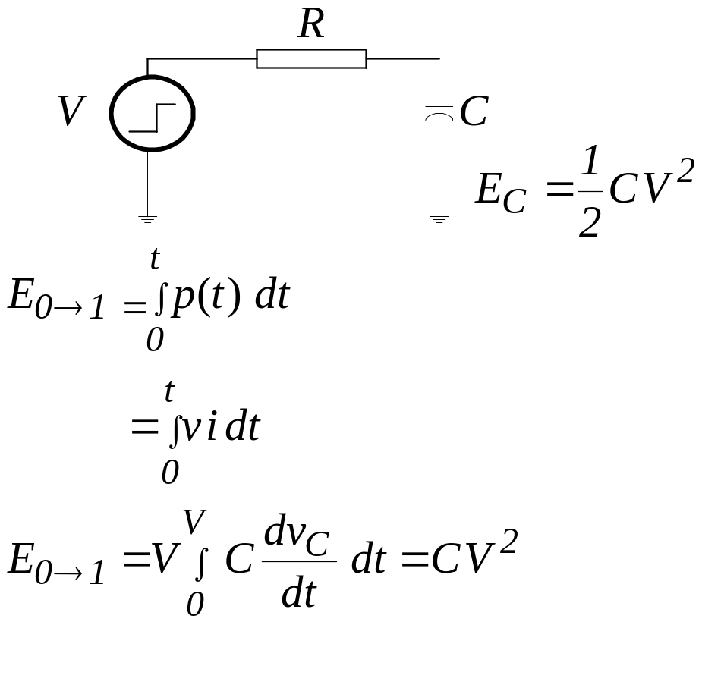
Dynamic Power dissipation
Charging of Capacitance
    - Applying a step input, Energy drawn from source
11/28/19
S Qureshi

Slide 11
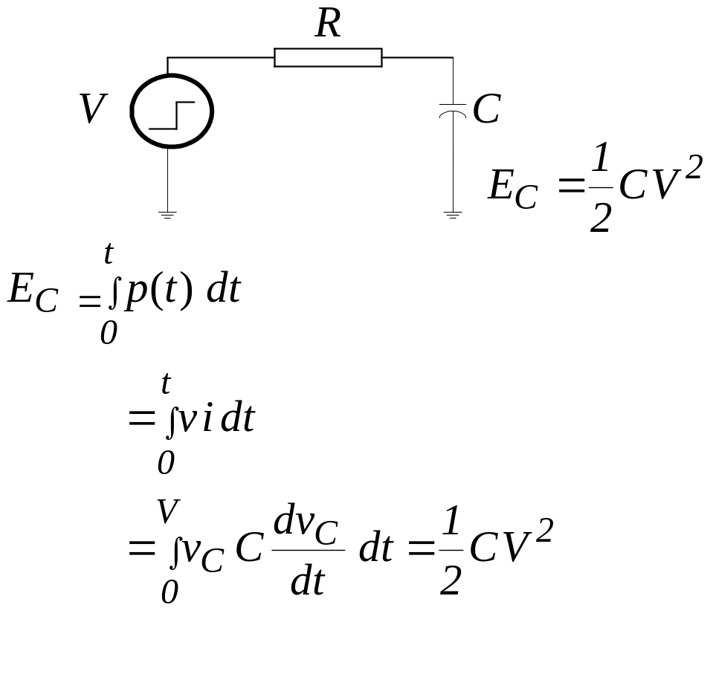
Dynamic Power dissipation
Charging of Capacitance
    - Energy stored in capacitor
11/28/19
S Qureshi

Slide 12
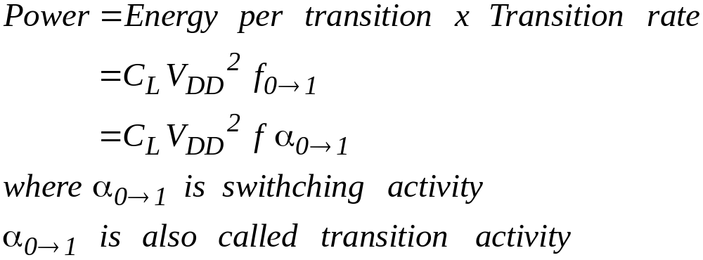
Dynamic Power dissipation
Dynamic Power
11/28/19
S Qureshi

Slide 13
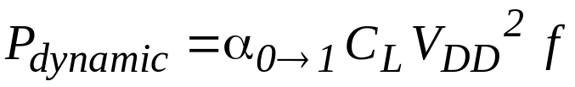
Dynamic Power dissipation
Switching Power dissipation
    - Due to charging of load and parasitic capacitances
Vdd
Vin
Vout
C
L
11/28/19
S Qureshi

Slide 14
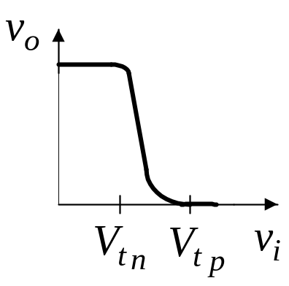
Dynamic Power dissipation
Short Circuit Power Dissipation
    - When input signal switches and lies between threshold voltage of NMOS and PMOS transistors both transistors are ON. This causes short circuit between Vdd and ground resulting in short circuit power dissipation
    - Short circuit power dissipation depends upon rise and fall time of input signal
    - Loading capacitance of gate
11/28/19
S Qureshi

Slide 15
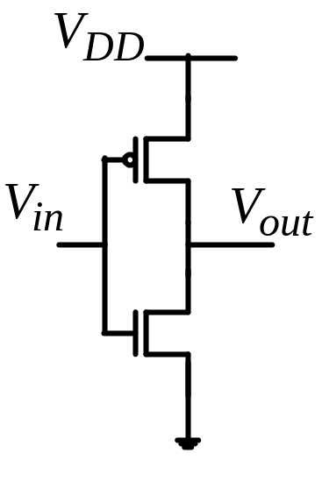
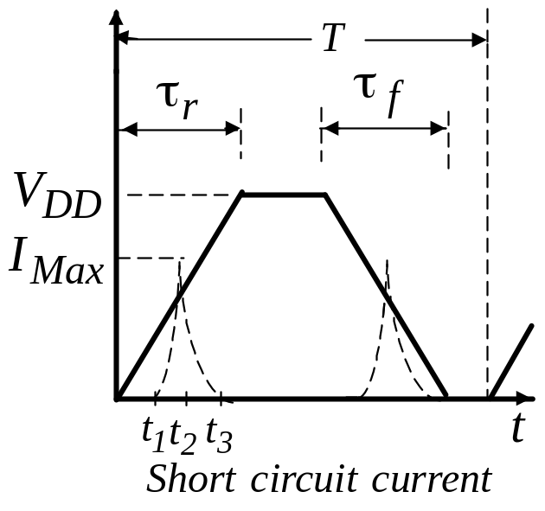
Dynamic Power dissipation
Short circuit power dissipation
- Exact analysis of short-circuit dissipation of inverter is complex.
Simplified analysis:
11/28/19
S Qureshi

Slide 16
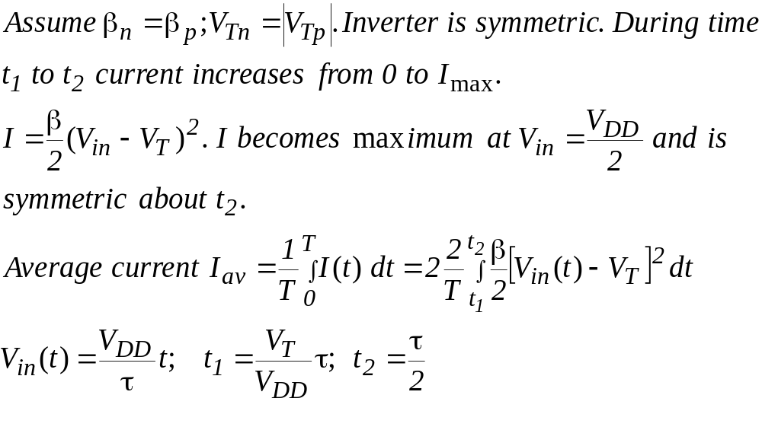
Dynamic Power dissipation
Short circuit power dissipation
Simplified analysis:
11/28/19
S Qureshi

Slide 17
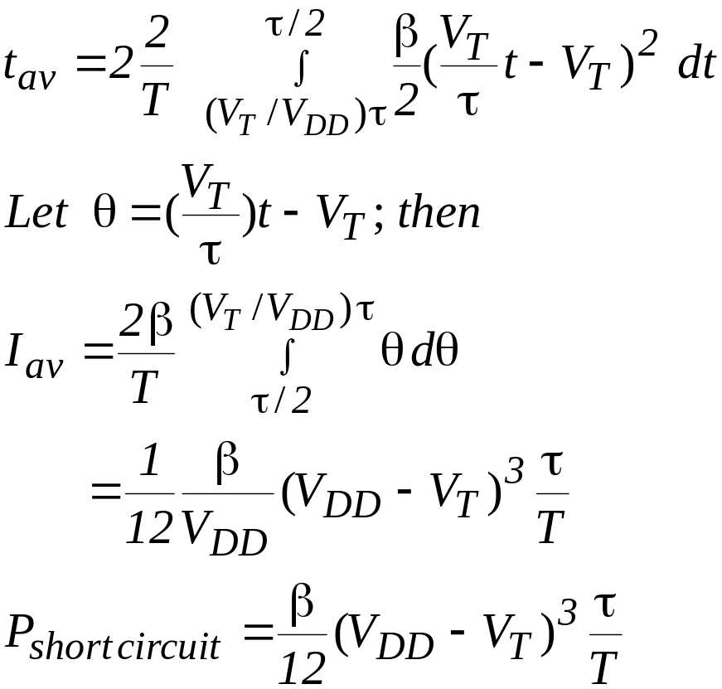
Dynamic Power dissipation
Short circuit power dissipation
Simplified analysis (cont):
11/28/19
S Qureshi

Slide 18
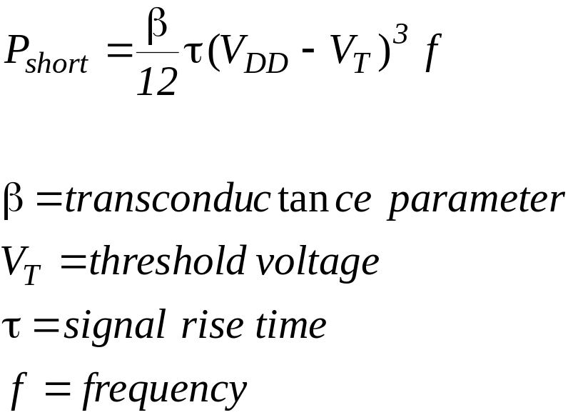
Dynamic Power dissipation
Short Circuit Power Dissipation
Psc is minimum when input and output have equal
rise and fall times
Veendrick 84
11/28/19
S Qureshi

Slide 19
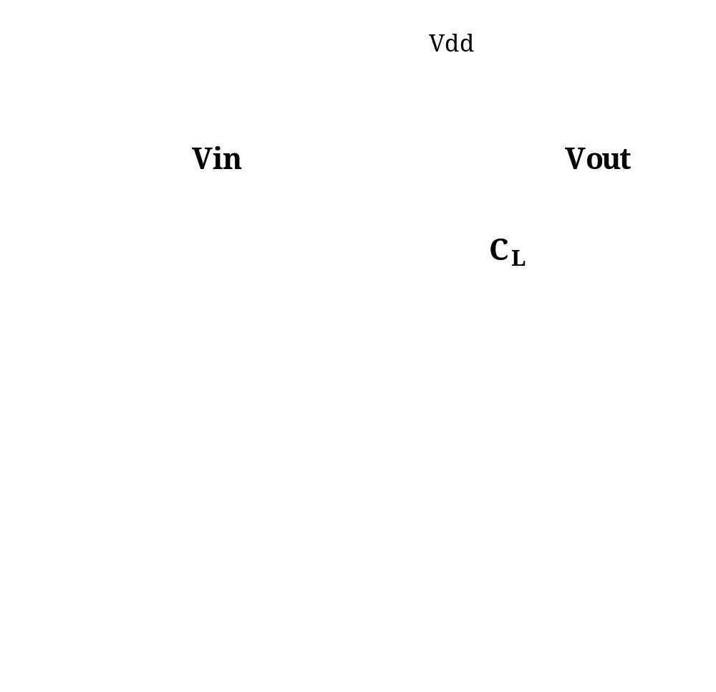
Dynamic Power dissipation
Short Circuit Power Dissipation
Rabaey 2003
11/28/19
S Qureshi

Slide 20
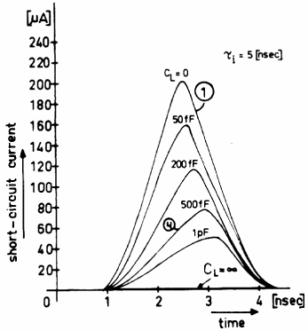
Dynamic Power dissipation
Short Circuit Power Dissipation
- Dependence of short circuit current on load capacitance
Rabaey 2003
11/28/19
S Qureshi

Slide 21
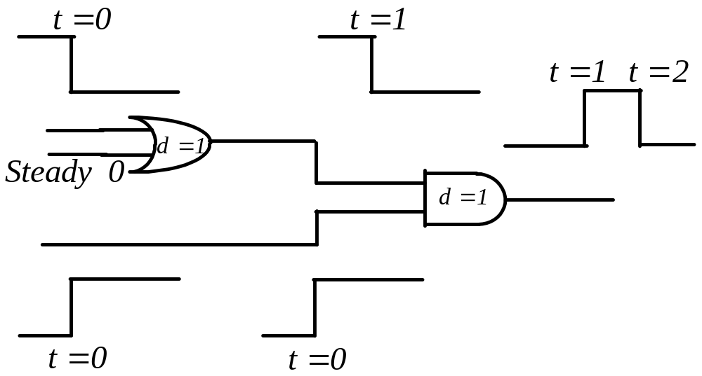
Dynamic Power dissipation
Glitching power
Glitches arise due to delays through different paths
(Spurious transitions)
11/28/19
S Qureshi

Slide 22
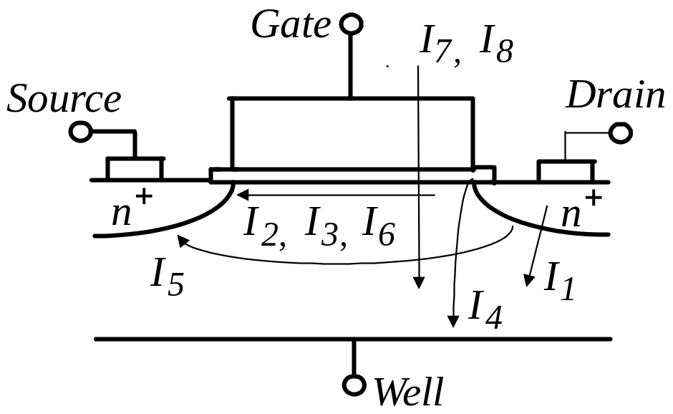
Static Power dissipation
Leakage mechanisms in deep submicron transistor
11/28/19
S Qureshi

Slide 23
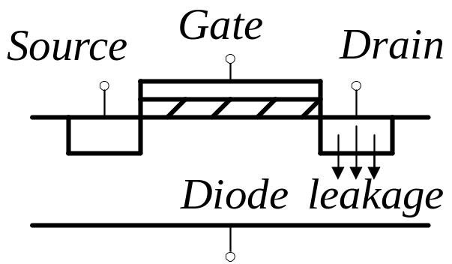
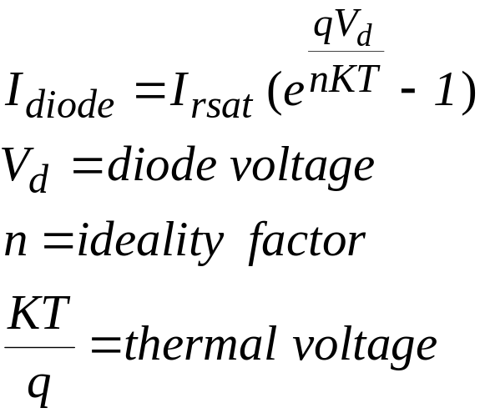
Static Power dissipation
Reverse-Bias Diode Leakage (I₁)
11/28/19
S Qureshi

Slide 24
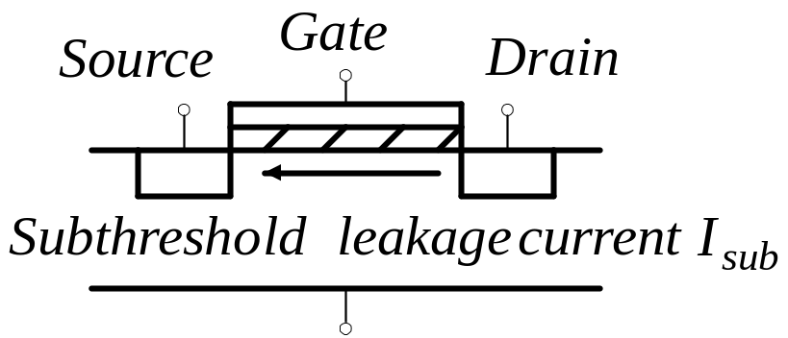
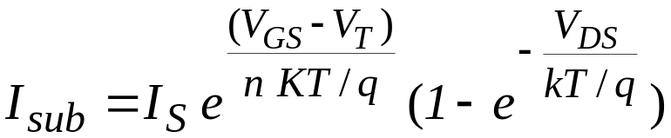
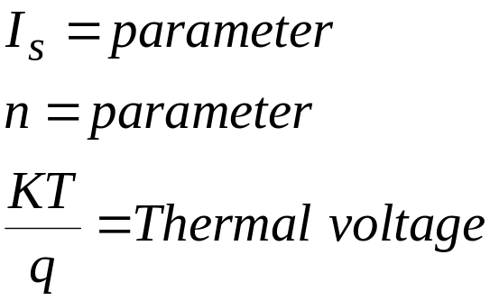
Static Power dissipation
Subthreshold Leakage Current (I₂)
11/28/19
S Qureshi

Slide 25
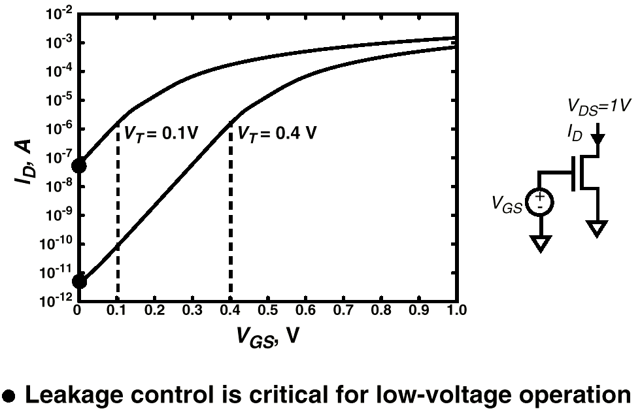
Static Power dissipation
Subthreshold Leakage Current
Rabaey 2003
11/28/19
S Qureshi

Slide 26
Static Power dissipation
Drain-induced barrier lowering effect (I₃)
DIBL occurs when depletion region of drain interacts with
source to lower source barrier potential.
Source injects carriers into channel without gate playing role
DIBL lowers threshold voltage without affecting subthreshold
slope
DIBL can be measured at constant V_{G} as change in I_{D} as V_{D}
changes
11/28/19
S Qureshi

Slide 27
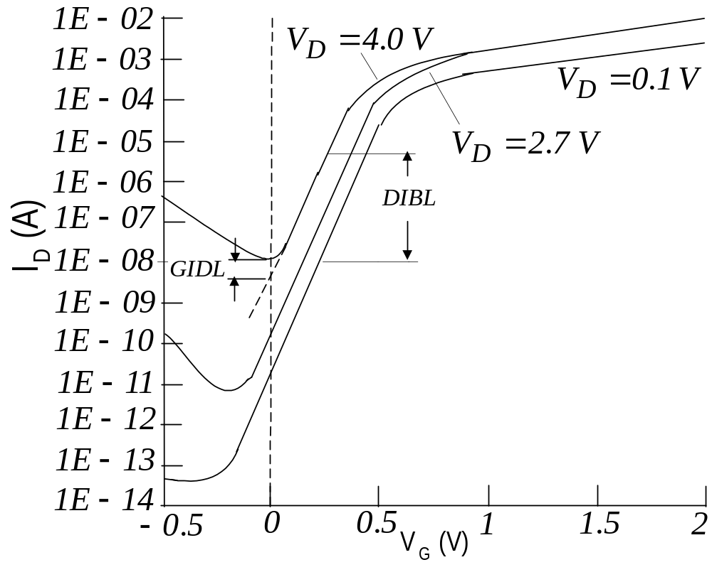
Static Power dissipation
Drain-induced barrier effect (I₃)
11/28/19
S Qureshi

Slide 28
Static Power dissipation
Gate-induced drain leakage GIDL current (I₄)
GIDL current arises in the high electric field under the gate/drain
overlap region causing deep depletion
GIDL current occurs at high V_{D} bias which generates
carriers in the substrate
Thinner t_{ox}, higher V_{DD} and lightly doped substrate enhance
electric field and GIDL current
GIDL current is a major obstacle in I_{OFF}
11/28/19
S Qureshi

Slide 29
Static Power dissipation
Punch through (I₅)
Punch through occurs when drain and source depletion region
approach each other electrically
Punch through gives rise to current deep inside substrate
Punch through causes current on which gate has no control
11/28/19
S Qureshi

Slide 30
Static Power dissipation
Narrow width (I₆)
Gate oxide tunneling (I₇)
High electric field can cause direct tunneling through the gate
Hot carrier injection (I₈)
Injection of hot carriers (electrons and holes) into oxide
11/28/19
S Qureshi

Slide 31
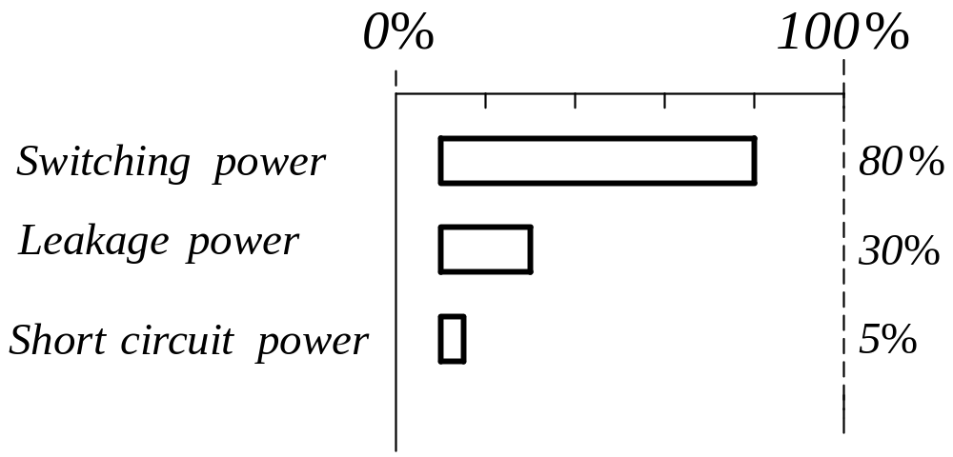
Contributions to Power dissipation
Component wise contribution
- With technology scaling leakage component is becoming
increasingly dominant
11/28/19
S Qureshi

Slide 32



Metric for low power design
    Power
    Power per MIPS
    Energy Delay
11/28/19
S Qureshi

Slide 33
Design Abstraction Levels
SYSTEM
MODULE
+
GATE
CIRCUIT
DEVICE
G
S
D
n+
n+
11/28/19
S Qureshi

Slide 34
Design Abstraction
Simulation at various levels of abstraction is Key in VLSI design
Main difference between various levels of abstraction
- Trade-off between computing resources and accuracy
    Simulation at lower level has better accuracy but increased computing resources needed
    Circuit simulator has better accuracy but cannot simulate full chip
    Logic level can handle full chip but accuracy not good
    Behavioral level simulation offers rapid analysis at the cost of accuracy
11/28/19
S Qureshi

Slide 35
Design Abstraction
Layered approach
Design optimization in general follows meet-in-the-middle
strategy
- Specifications and requirements propagate from top down
- Constraints propagate upwards from lowest abstraction
11/28/19
S Qureshi

Slide 36
Circuit Level Approach
Power Reduction Techniques at circuit level has good impact on overall power saving
Major impact especially in cell based design as cells are repeated thousands of times on a chip
Circuit level techniques even with small percentage improvement in power saving not to be ignored
11/28/19
S Qureshi

Slide 37
Circuit design style
Look at Circuit Design from power dissipation point of view
Non-clocked logic
- Fully complementary logic
    Excellent from ease of design, low power dissipation,
    low sensitivity to noise and process variations
    Poorer performance
11/28/19
S Qureshi

Slide 38
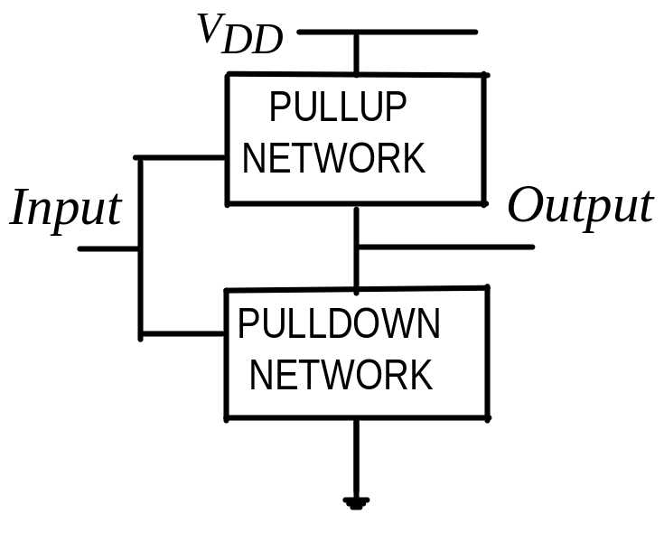
Circuit design style
Fully complementary logic
    Dynamic power
    - Switching power
    - Short circuit power
    - Glitching power
    Standby power
    - Due to leakage through transistor
    - For large V_{T} transistor leakage power can be neglected
    - Low threshold voltage gives better performance for ultra low power designs
11/28/19
S Qureshi

Slide 39
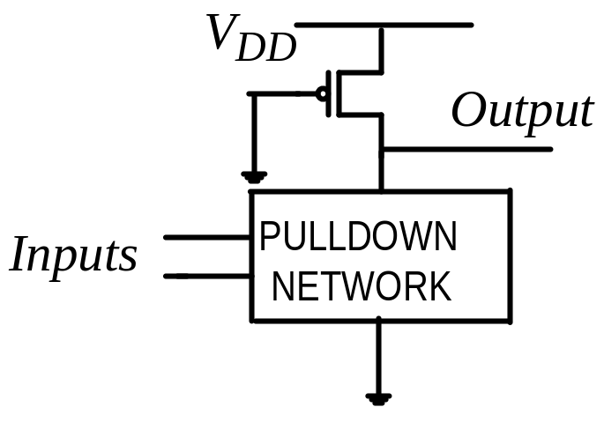
Circuit design style
Pseudo NMOS logic style
- PMOS load
    Power dissipation higher than
    Complementary CMOS
    - Suffers from Static power dissipation
    when pull down network is ON
    Faster speed due to reduced capacitance
    -
11/28/19
S Qureshi

Slide 40
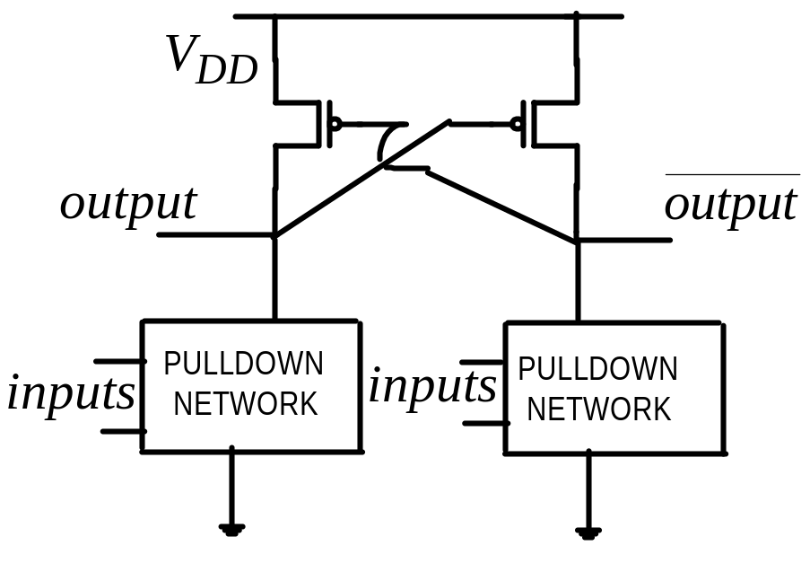
Circuit design style
Differential Cascade Voltage Switch Logic (DCVSL)
    Eliminates static power dissipation
    Provides output and its
    complement
    Increase in area and switched
    capacitance
    Increase in dynamic power dissipation
    in comparison to pseudo-NMOS
11/28/19
S Qureshi

Slide 41
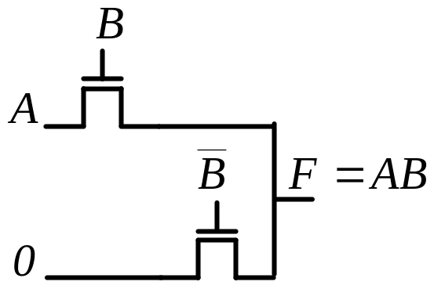
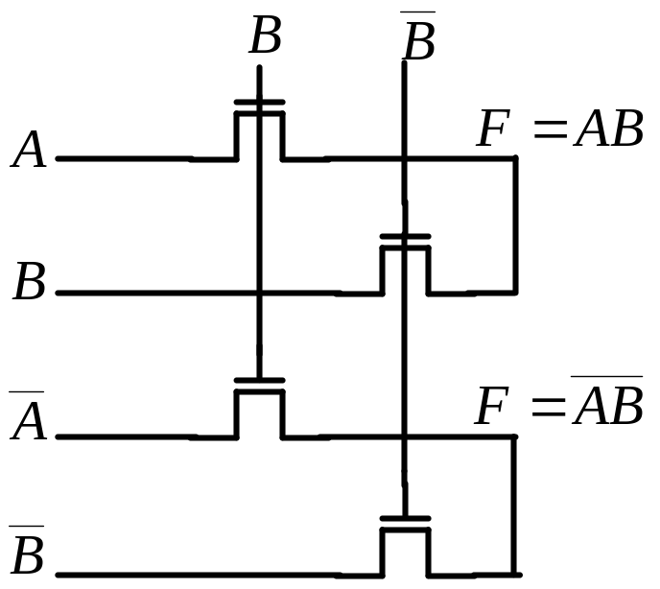
Circuit design style
Pass Transistor Logic (PTL / CPL)
- Transistors in series as switches or in parallel
    Advantage is logic is fast and can
    implement complex logic with few
    transistors
    NMOS does not transmit strong 1 hence level restorers are used
    Reduced voltage swing hence reduced power dissipation possible
11/28/19
S Qureshi

Slide 42
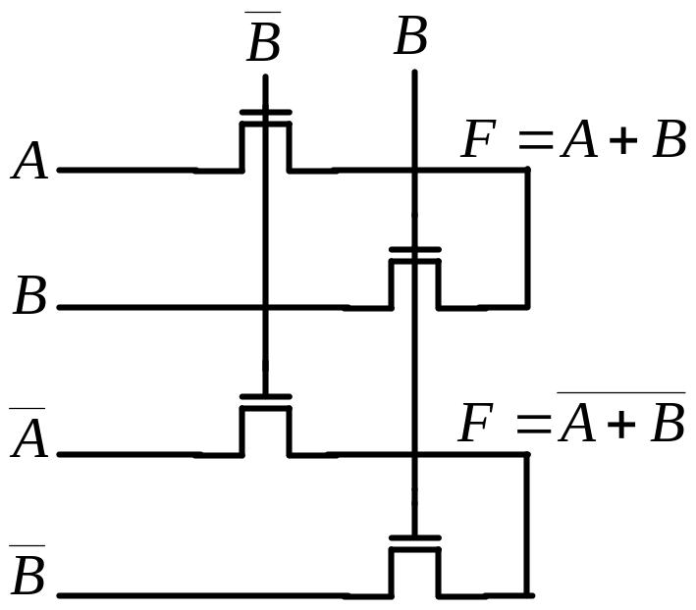
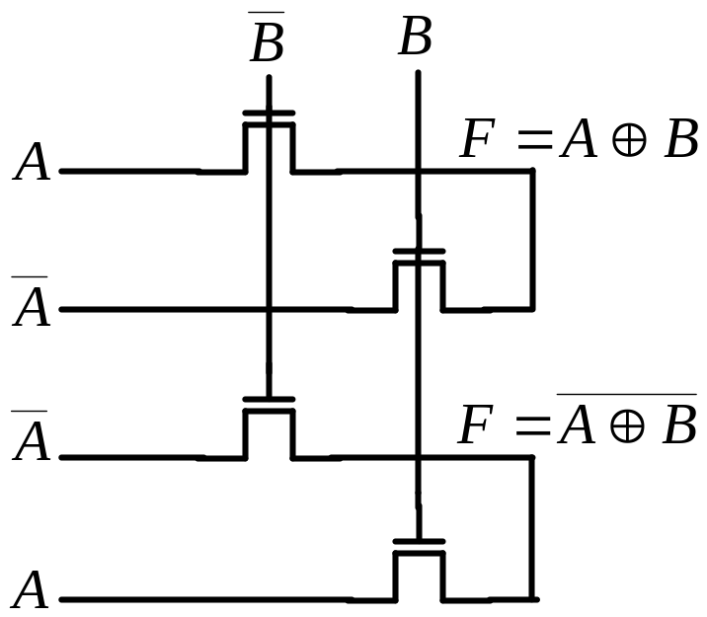
Circuit design style
Pass Transistor Logic (PTL/ CPL)
- Other Example of CPL
11/28/19
S Qureshi

Slide 43
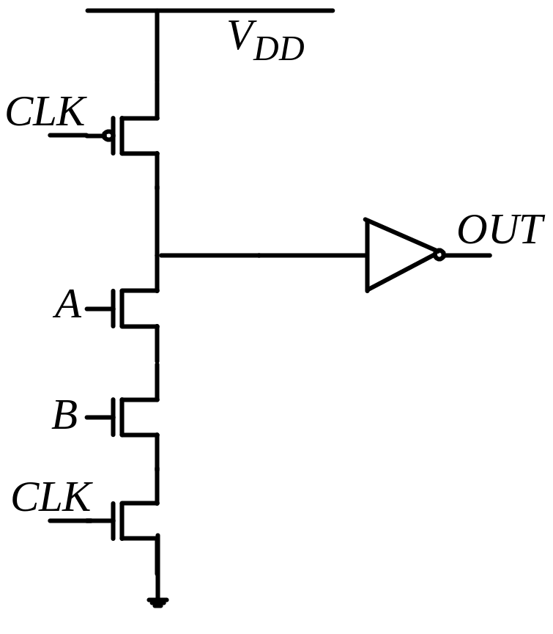
Circuit design style
Clocked Logic Family
- Clocked logic family generally faster than
static logic but consumes more power
- Domino Logic
    Domino circuits are non-
    inverting and not easy to use
    Power dissipation high
11/28/19
S Qureshi

Slide 44

Power consumption in logic gates
Power dissipation strong function of
    Transistor sizing which affects physical capacitance
    Input and output rise time which determines short-circuit power
    Device threshold voltage having impact on leakage power
    Switching activity or transition activity
11/28/19
S Qureshi

Slide 45

Power consumption in logic gates
Switching activity or transition activity of gate
    Strong function of logic function being implemented
    For static CMOS gates switching activity is probability p₀
    that output is in zero state multiplied by probability p₁
    that output is 1 in next cycle
11/28/19
S Qureshi

Slide 46
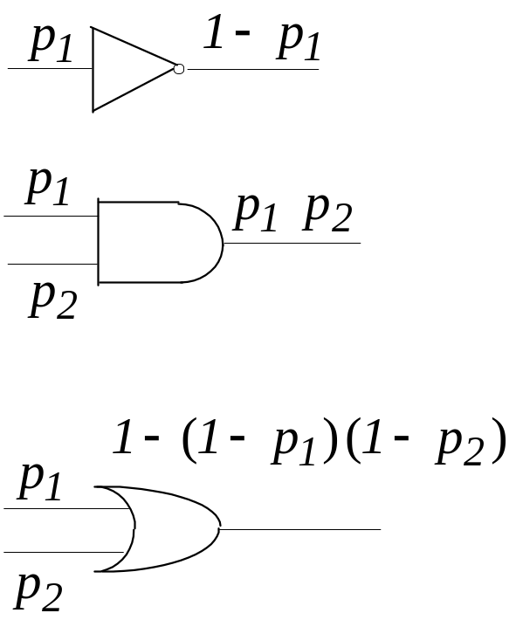
Power consumption in logic gates
Signal probability p
- probability signal assumes value of 1 that is p ( g=1)
For NOT gate if input signal probability is p₁
- Output signal probability is 1- p₁
For AND gate if input signal probability is p₁ and p₂
- Output signal probability is p₁ p₂
For Or gate if input signal probability is p₁ and p₂
- Output signal probability is 1- (1- p₁)(1- p₂ )
11/28/19
S Qureshi

Slide 47
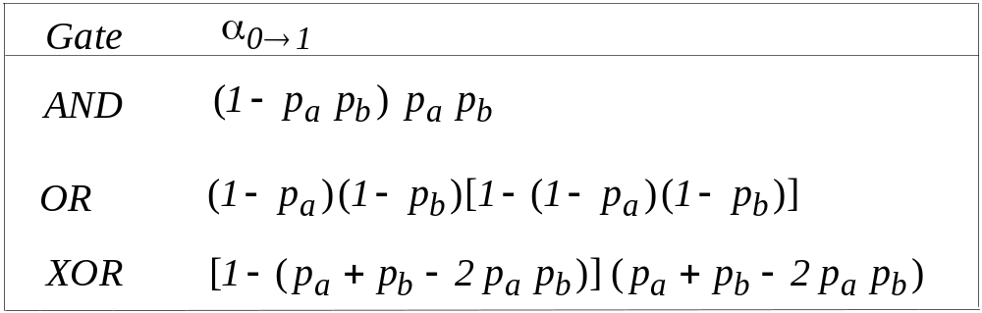
Signal Switching Activity
11/28/19
S Qureshi

Slide 48
Techniques for reducing switching activity
Shifter instead of Multiplier
In XOR gate every input transition causes output transition
Not so for AND, NAND, OR, NOR
XOR Gate more power hungry
Multipliers and Adder use large number of XOR Gates
- Single input transition causes number of transitions internal to Adder
Multiplier
User left Shift instead to have multiplication and right shift for division
11/28/19
S Qureshi

Slide 49
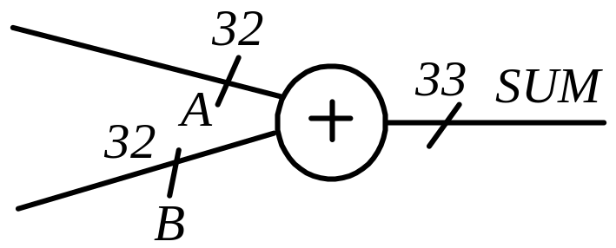
Techniques for reducing switching activity
Operand Isolation
Addition of two 32 bit signals
All 32 bits do not arrive same time
Arrival of Each bit can cause switching
activity in adder with power dissipation
Latching each input will reduce the
problem of unnecessary switching
activity
11/28/19
S Qureshi

Slide 50
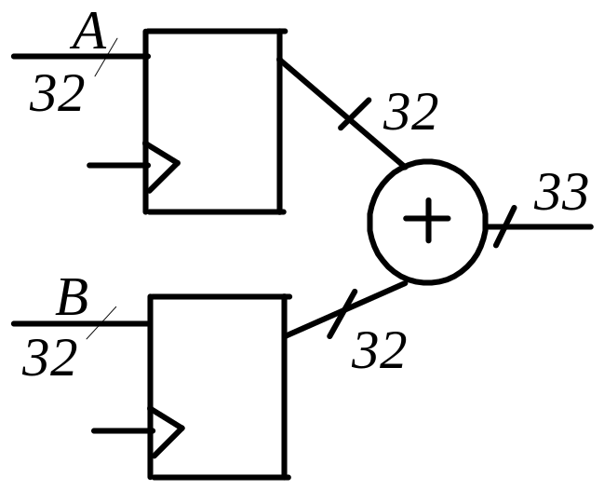
Techniques for reducing switching activity
Operand Isolation
Latching operands
All operands come from registers
almost same time
Area penalty
Increase by one clock cycle in latency
11/28/19
S Qureshi

Slide 51
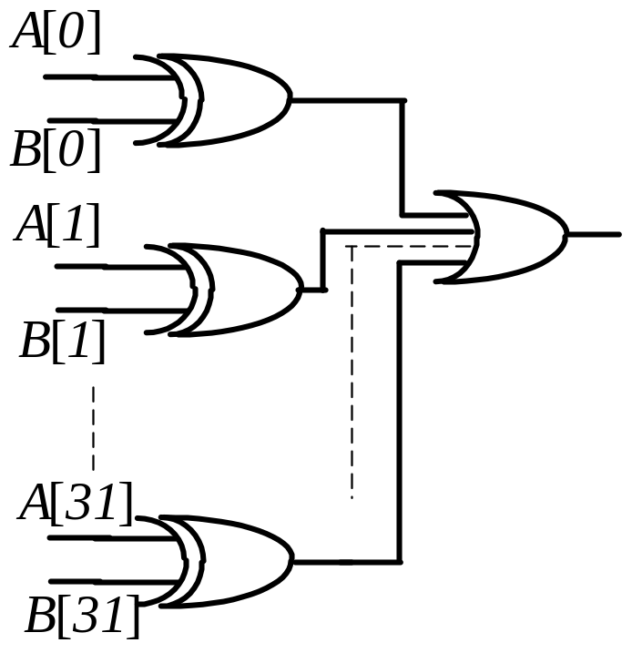
Techniques for reducing switching activity
Avoid Comparison
Comparison of large Data busses
using comparators
Comparator operations involve XORs
Avoid comparisons of all bits in one go.
- compare MSB to avoid power loss
due to intermediate transitions
- only lower bits be involved if MSB is
non-diagnostic
11/28/19
S Qureshi

Slide 52
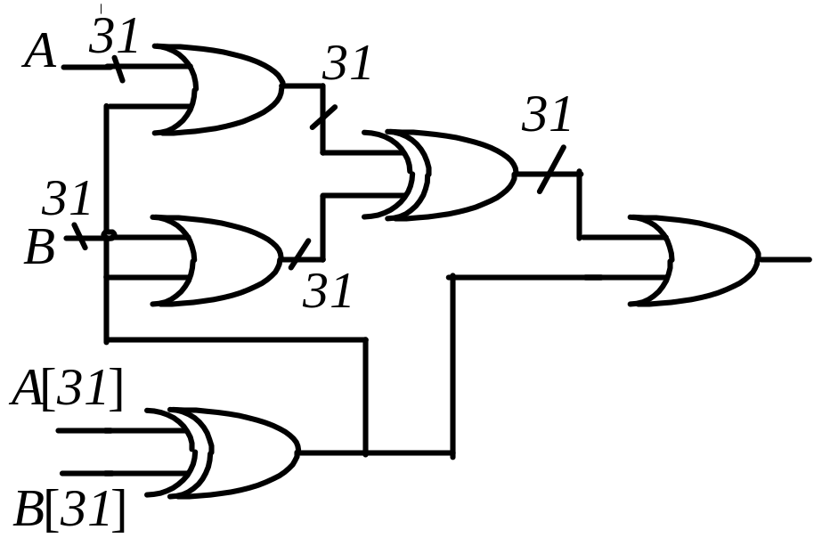
Techniques for reducing switching activity
Compare MSB
Comparison of MSB done first
If comparison is sufficient other
bits are prevented from taking
part
if MSB not sufficient other bits
allowed to go to XOR Gates
Additional area required
11/28/19
S Qureshi

Slide 53
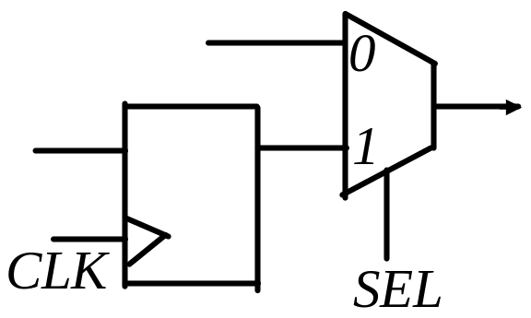
Techniques for reducing switching activity
Clock Gating
Most effective method to reduce
switching activity
For positive-edge triggered F/F no
change in output for negative- edge
When output is not sampled positive
clock edge will only cause power
dissipation
When input is not changing there is
no point in sampling
11/28/19
S Qureshi

Slide 54
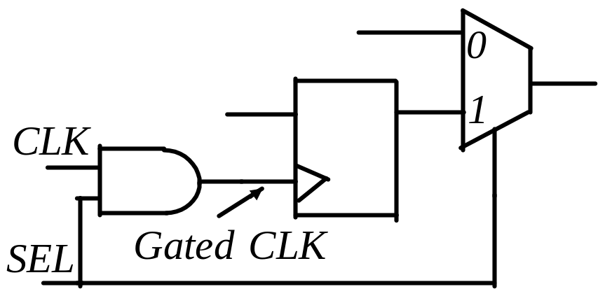
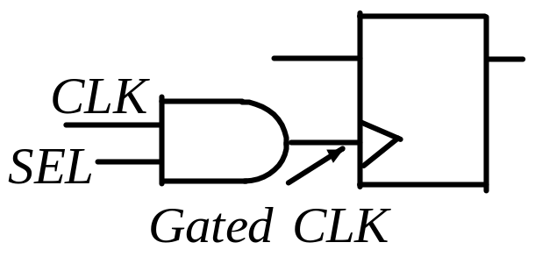
Techniques for reducing switching activity
Clock Gating
When F/F output is not used it is
blocked at NAND Gate unless
select is enabled
No switching activity when select
not enabled
11/28/19
S Qureshi

Slide 55
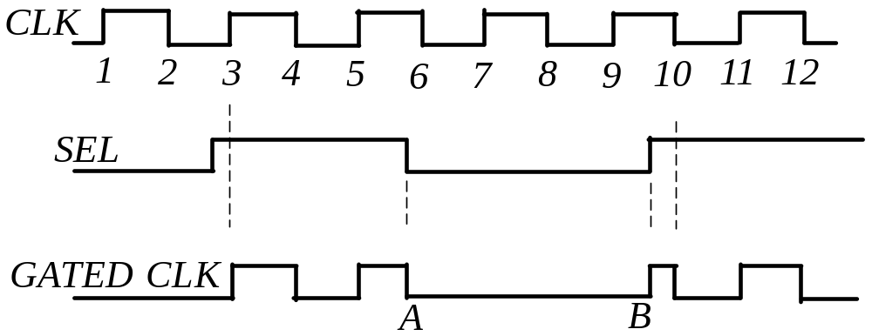
Techniques for reducing switching activity
Pulse Clipping and Spurious Clocking
Due to gating 1, 2, 7, 8, 9 are blocked
to reach F/F clock thus saving power
At point A falling edge should come at
6 but comes earlier and causes pulse
chopping; At point B positive edge can
cause timing violation
11/28/19
S Qureshi

Slide 56
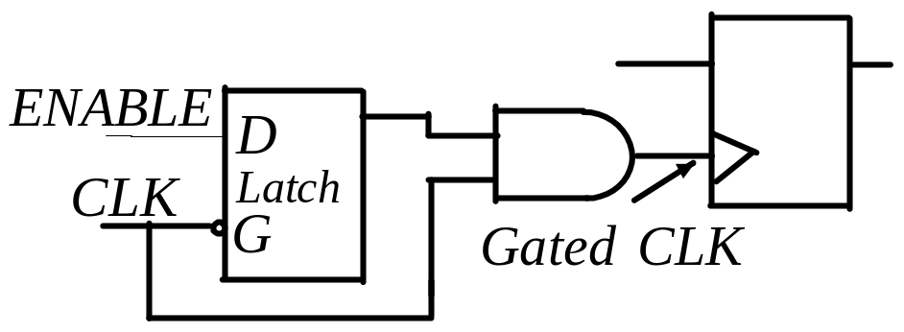
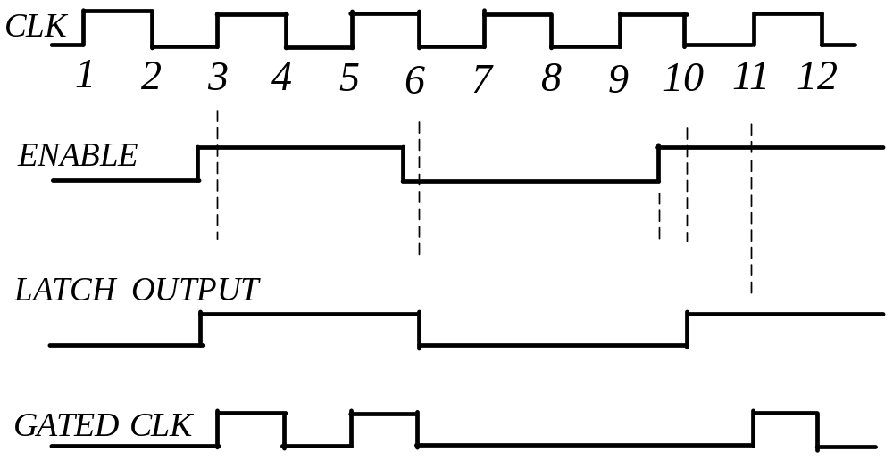
Techniques for reducing switching activity
Preventing Clipping and Spurious Clocking
Enable signal reaches gate
only when clock is low
11/28/19
S Qureshi

Slide 57
Low Power Design Methodology
There is need to apply low power design methodologies through entire design process from system level to layout
Design flow starts with system specification followed by following steps to get to layout
11/28/19
S Qureshi

Slide 58
Low Power Design Metodology
System Level Low Power Design Flow
    Create design in System Verilog
    Simulate design
    Create / Synthesize different versions
    Evaluate Power
    Choose Lower Power Version
    802.11a transmitter, Dave 06 , MIT
11/28/19
S Qureshi

Slide 59


Low Power Design Metodology
Key Low Power Design Objectives in Design Phase
    Minimization of effective frequency
    Does not mean reduce clock frequency but how often clock toggles, in other words
    Clock gating
    Data gating
    Memory system design
11/28/19
S Qureshi

Slide 60
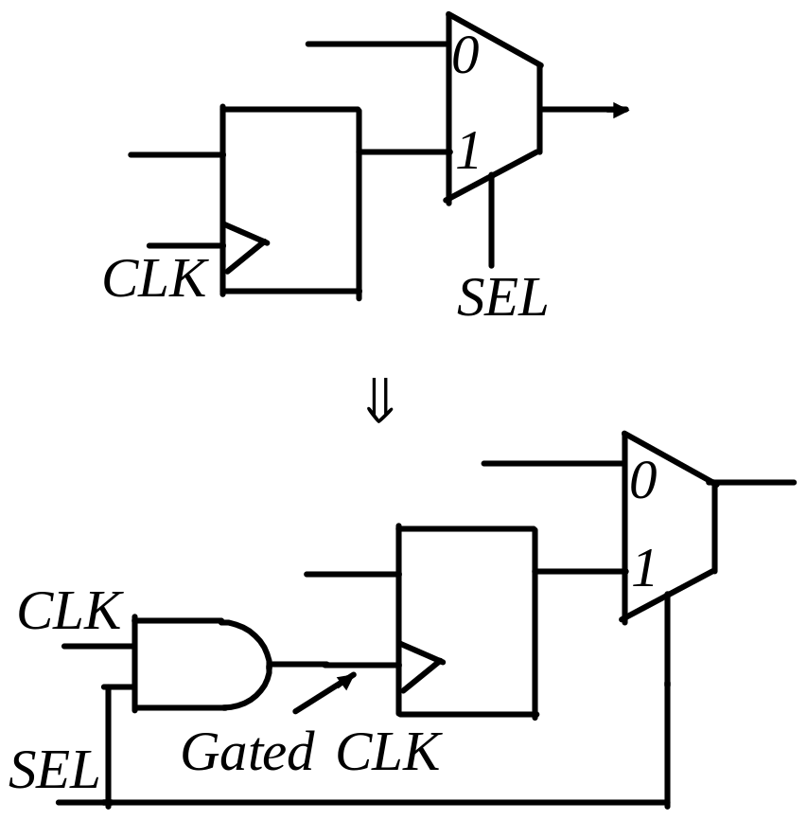
Low Power Design Methodology
Clock Gating
Local Gating
11/28/19
S Qureshi

Slide 61
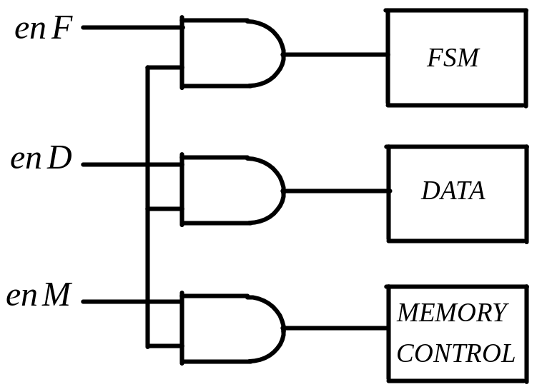
Low Power Design Methodology
Clock Gating
Global Gating
11/28/19
S Qureshi

Slide 62
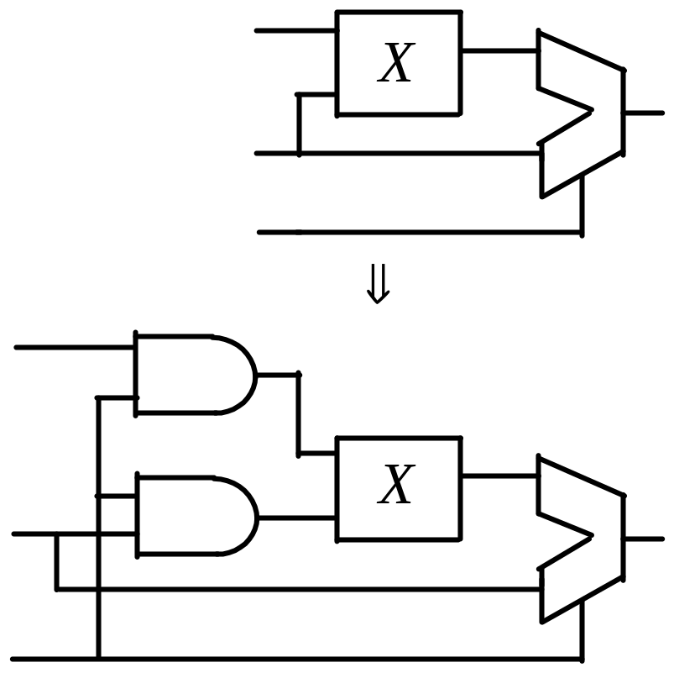
Low Power Design Methodology
Data Gating
Inputs to Multiplier feeding ALU
Inputs prevented to ripple
through multiplier saving power
giving low power version
11/28/19
S Qureshi

Slide 63
Principles of Low Power design
    Use lowest possible voltage
    Use smallest geometry, highest frequency devices operated
    at lowest possible frequency
    Use parallelism and pipelining to lower required frequency of
    operation
    Energy Power management by disconnecting power source when
    system is idle
11/28/19
S Qureshi

Slide 64
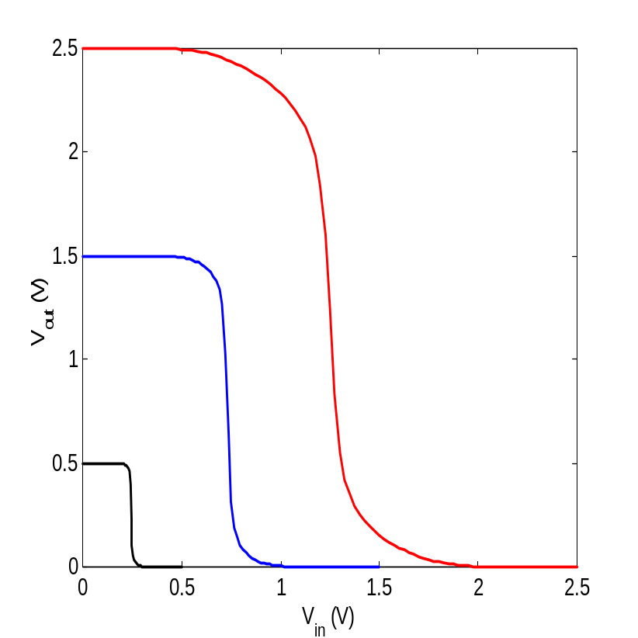
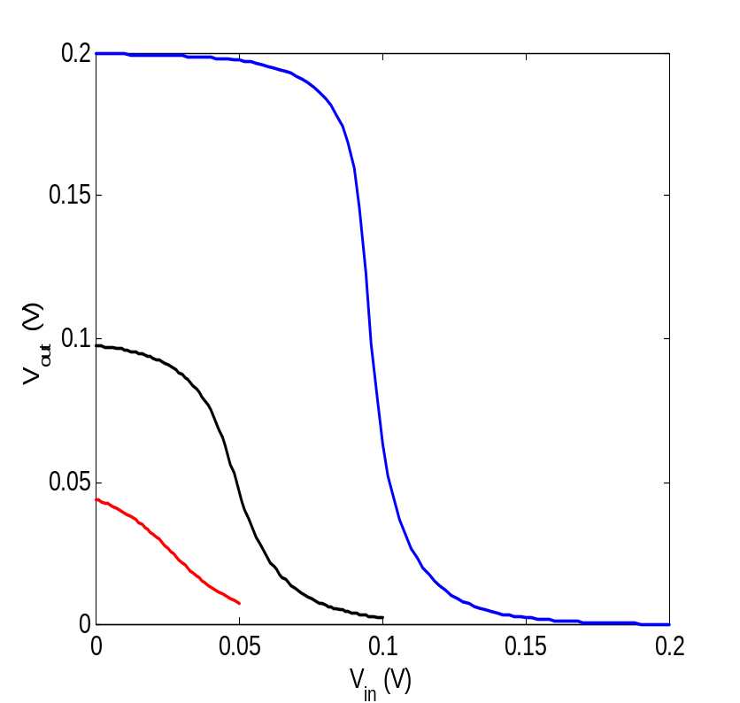
Supply Voltage Scaling Approach
Scaling of Supply voltage of CMOS inverter
–Theoretical limit VDD > 2…4 KT/q
11/28/19
S Qureshi
Rabaey 2003

Slide 65
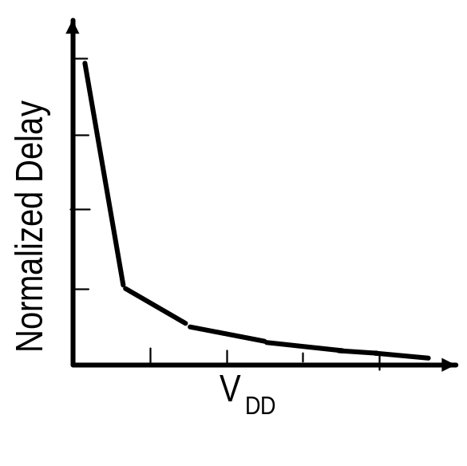
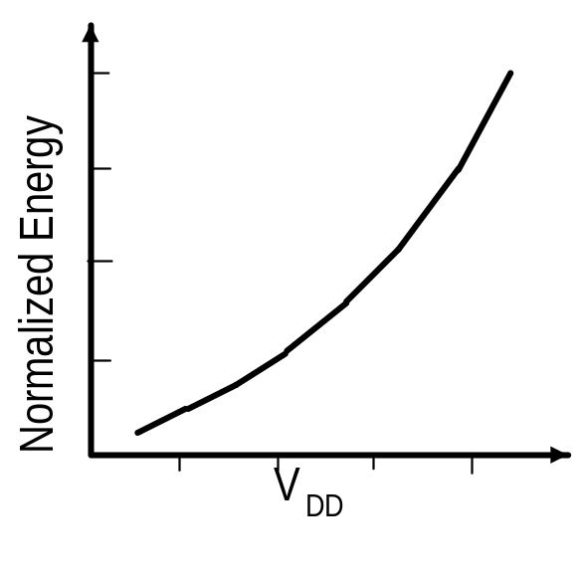
Supply Voltage Scaling Approach
Supply voltage scaling for low power
- Factor of two reduction in supply voltage yields factor of four decrease in energy
- Theoretical lower limit of supply voltage for CMOS is 0.2 V
- Trade-off for supply voltage lowering is increase in delay leading to dramatic reduction in performance
11/28/19
S Qureshi

Slide 66
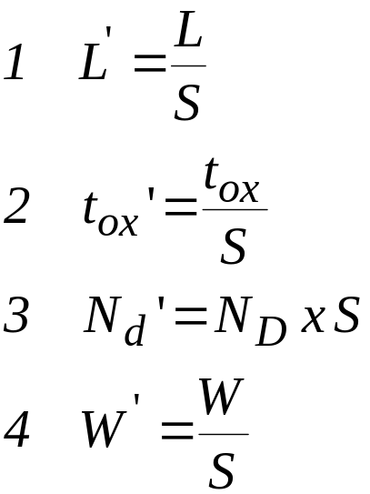


Supply Voltage Scaling Approach
Delay increases due to voltage reduction
Increase in delay can be compensated by scaling down device sizes
Submicron capacitances do not scale proportionately and can become dominant
11/28/19
S Qureshi

Slide 67
Architectural Approach with Voltage Scaling
Architectural transformation to compensate for delay is attractive while achieving lower power dissipation. Use two approaches
Parallelism
pipelining
- Illustrate with a data path
11/28/19
S Qureshi

Slide 68


Architectural Approach with Voltage Scaling
Parallelism
11/28/19
S Qureshi

Slide 69


Architectural Approach with Voltage Scaling
Parallelism
Area overhead
11/28/19
S Qureshi

Slide 70



Pipelining
Reference
Pipelined
Rabaey 2003
11/28/19
S Qureshi

Slide 71

Architectural Approach with Voltage Scaling
Un-pipelined
11/28/19
S Qureshi

Slide 72


Architectural Approach with Voltage Scaling
Pipelined
11/28/19
S Qureshi

Slide 73
Threshold Voltage Scaling
Deep submicron device design issues
Scaling down of feature size leads to improved performance and high
device density
11/28/19
S Qureshi

Slide 74
Threshold Voltage Scaling
Subthreshold Leakage Current
11/28/19
S Qureshi

Slide 75

Threshold Voltage Scaling
Threshold voltage scaling done in low power circuits to improve performance
11/28/19
S Qureshi

Slide 76
Threshold Voltage Scaling
Fabrication of Multiple Threshold Voltage Circuits
- Different Threshold Voltage used during different
modes of operation
Multiple channel doping
Multiple oxide thickness
Multiple channel length
Multiple body bias
Various Approaches used
Variable-threshold Voltage CMOS (VTCMOS)
Multi-threshold Voltage CMOS (MTCMOS) approach
Dual-threshold Voltage CMOS approach
11/28/19
S Qureshi

Slide 77

Threshold Voltage Scaling
VTCMOS Approach by changing body bias
11/28/19
S Qureshi

Slide 78

Threshold Voltage Scaling
MTCMOS Approach uses both both high and low threshold MOSFETs in single chip obtained by implantation and sleep control scheme
11/28/19
S Qureshi

Slide 79
Threshold Voltage Scaling
MTCMOS approach uses both both high and low threshold MOSFETs in single chip obtained by implantation and sleep control scheme
In active mode SL is high and Mp and Mn are ON. VDDV and GNDV are
real power and ground.
In sleep mode SL is low. Mn and Mp are OFF. VDDV and GNDV are
floating.
Leakage current is suppressed by high threshold voltage MOSFETs
11/28/19
S Qureshi

Slide 80


Threshold Voltage Scaling
MTCMOS Performance
11/28/19
S Qureshi

Slide 81
Threshold Voltage Scaling
MTCMOS Advantages and limitations
Technique is simple and easily implemented
MTCMOS reduces standby power only
Sleep control transistors can be large in size and increase area and delay
Extra memory circuitry required to maintain data in sleep mode
11/28/19
S Qureshi

Slide 82
Sub-threshold Design for Low Power
Sub-threshold circuits ideal for applications where performance is not critical
Minimum energy consumption is key
- Examples:
Hearing-aid application,
Ultra-low power registers,
SRAMS
11/28/19
S Qureshi

Slide 83

Sub-threshold Design for Low Power
Sub-threshold
operation
11/28/19
S Qureshi

Slide 84

Sub-threshold Design for Low Power
Sub-threshold Leakage Current Model
11/28/19
S Qureshi

Slide 85

Sub-threshold Design for Low Power
Sub-threshold Leakage Current Model
11/28/19
S Qureshi

Slide 86

Sub-threshold Design for Low Power
Digital Logic
Inverter Operation in Sub-threshold region
V_{DD} scaling in sub-threshold region has limit ~ 3- 4 KT/q
Reason for degradation is low I_{on}/I_{off}
Small I_{on} implies slower speed
11/28/19
S Qureshi

Slide 87

Sub-threshold Design for Low Power
Digital Logic
VTC of Inverter in Sub-threshold region
11/28/19
S Qureshi

Slide 88

Sub-threshold Design for Low Power
Digital Logic
VTC for Inverter in Sub-threshold region
11/28/19
S Qureshi

Slide 89

Sub-threshold Design for Low Power
Digital Logic
9 stage Ring Oscillator using inverter
11/28/19
S Qureshi

Slide 90

Sub-threshold Design for Low Power
Digital Logic
XOR Gate using transmission gate for sub-threshold region
11/28/19
S Qureshi

Slide 91
Thank You !!!
11/28/19
S Qureshi

